Slide 1


Slide 2
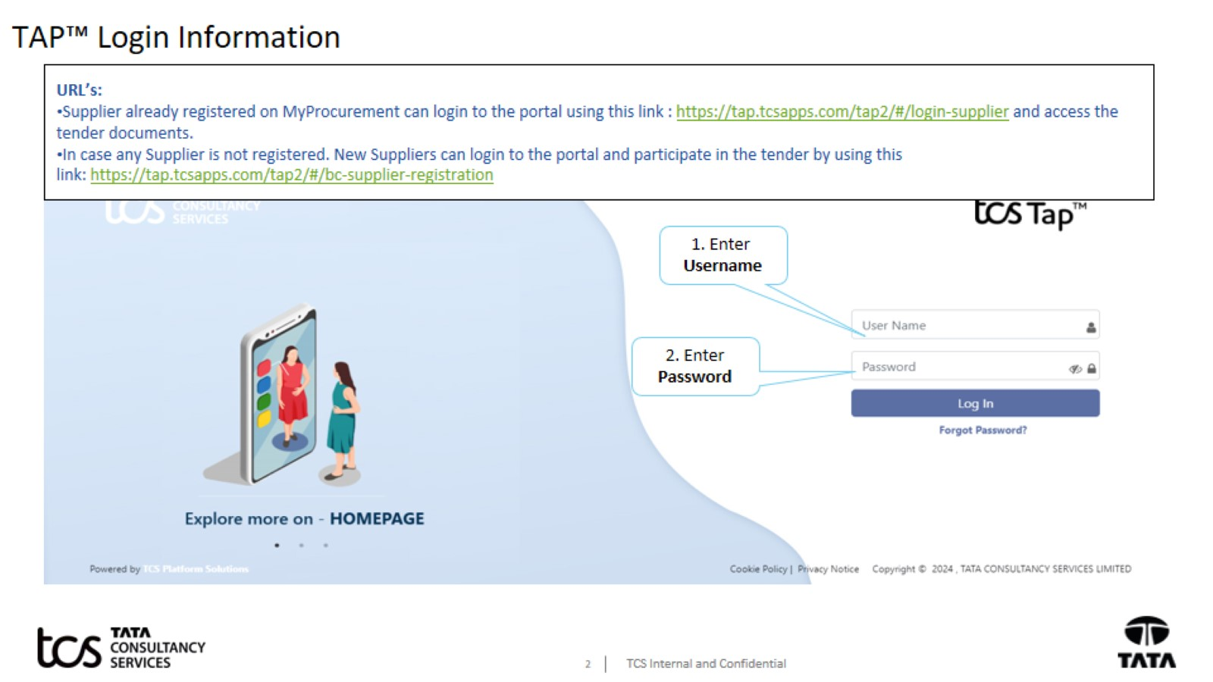
TAP™ Login Information

Slide 3
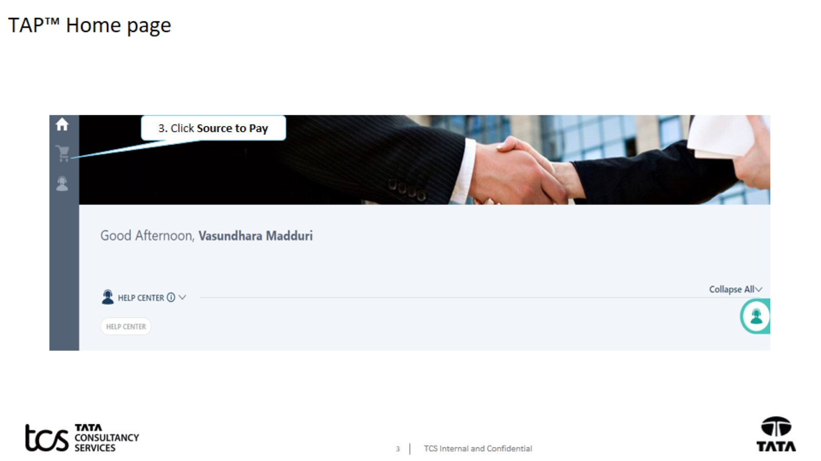
TAP™ Home page

Slide 4

Supplier Response

Slide 5
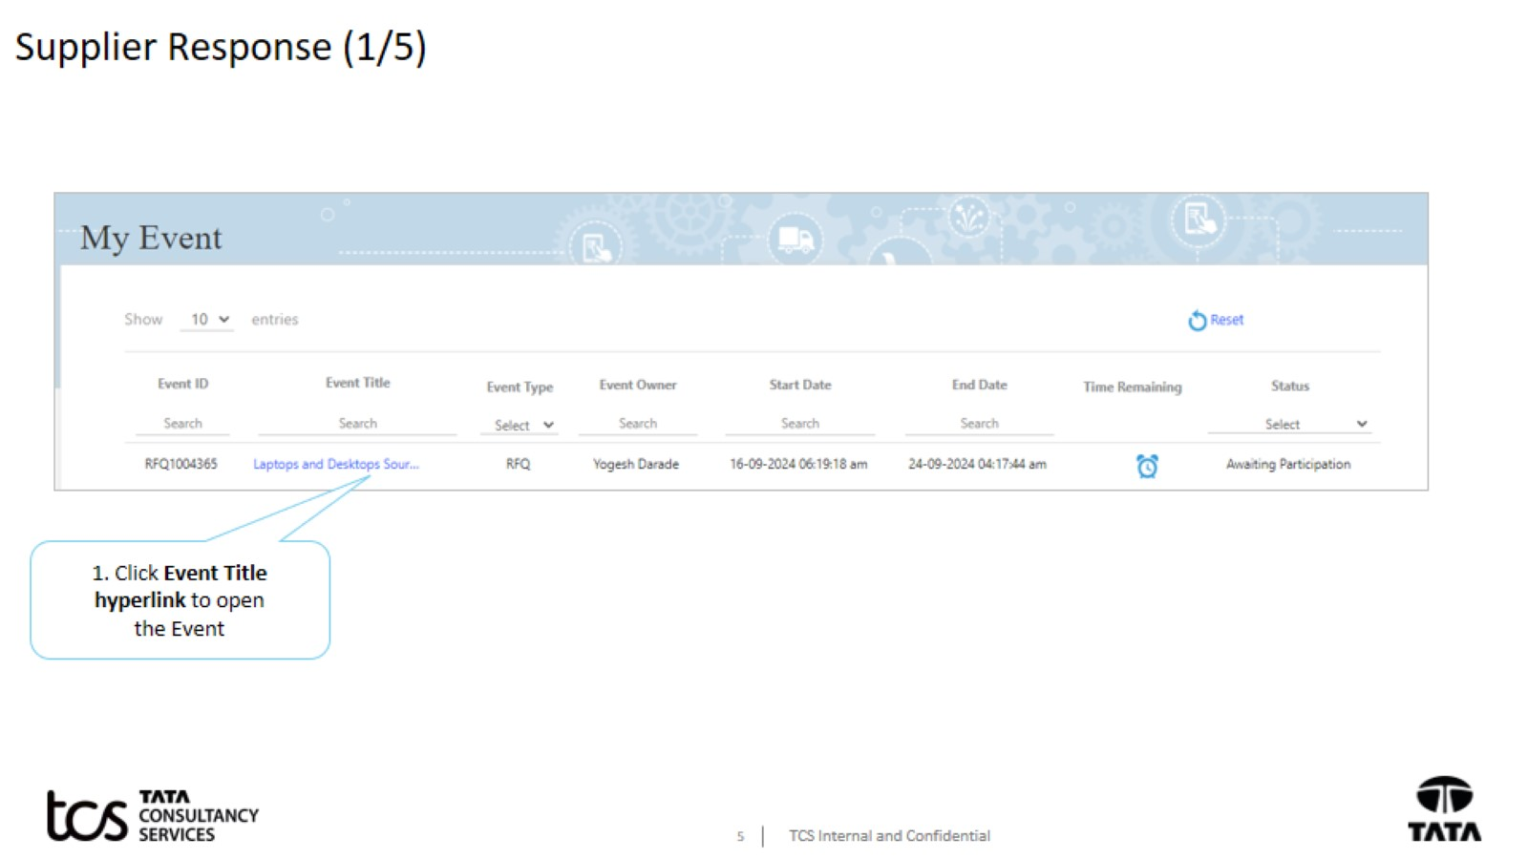
Supplier Response (1/5)

Slide 6
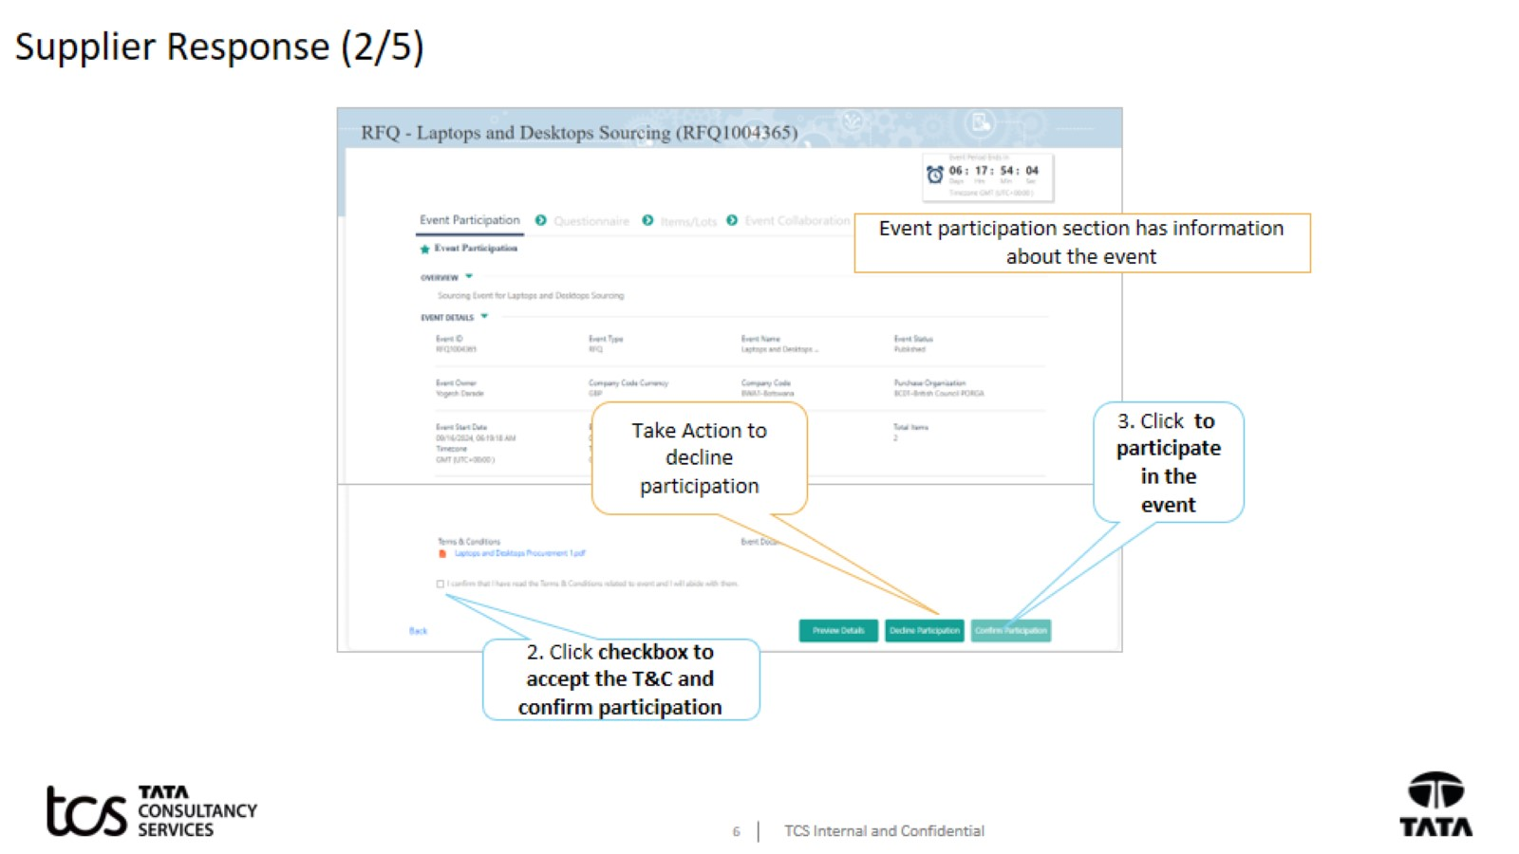
Supplier Response (2/5)

Slide 7
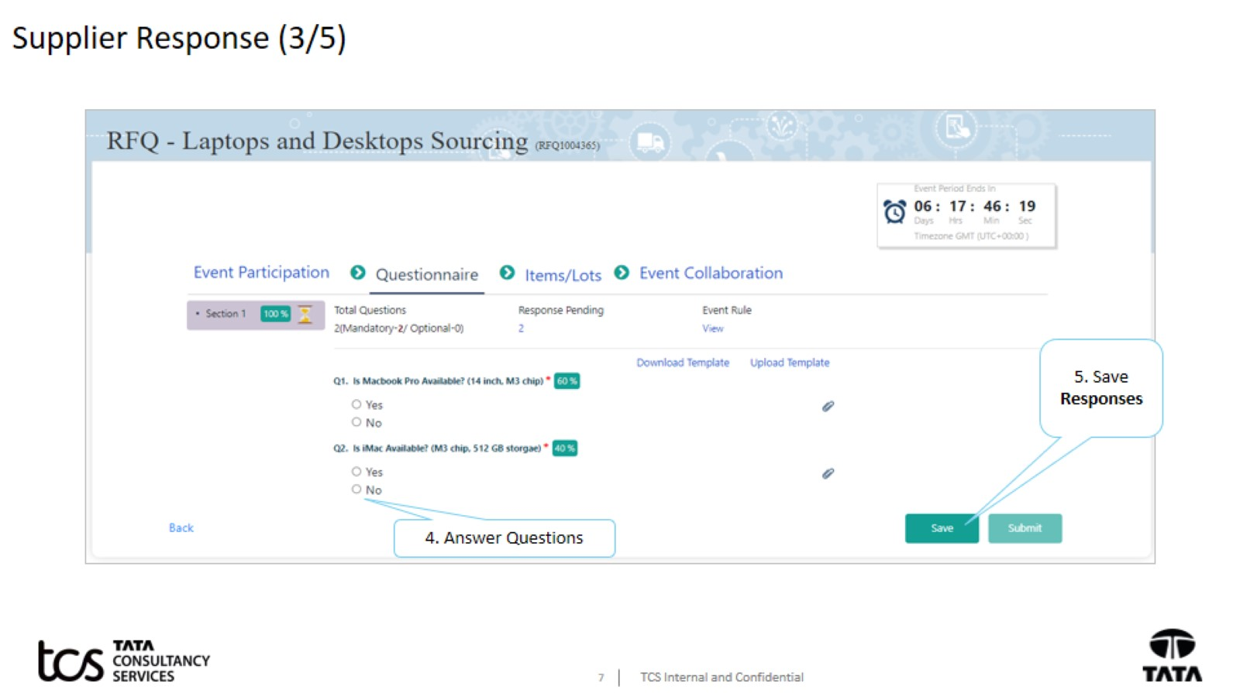
Supplier Response (3/5)

Slide 8
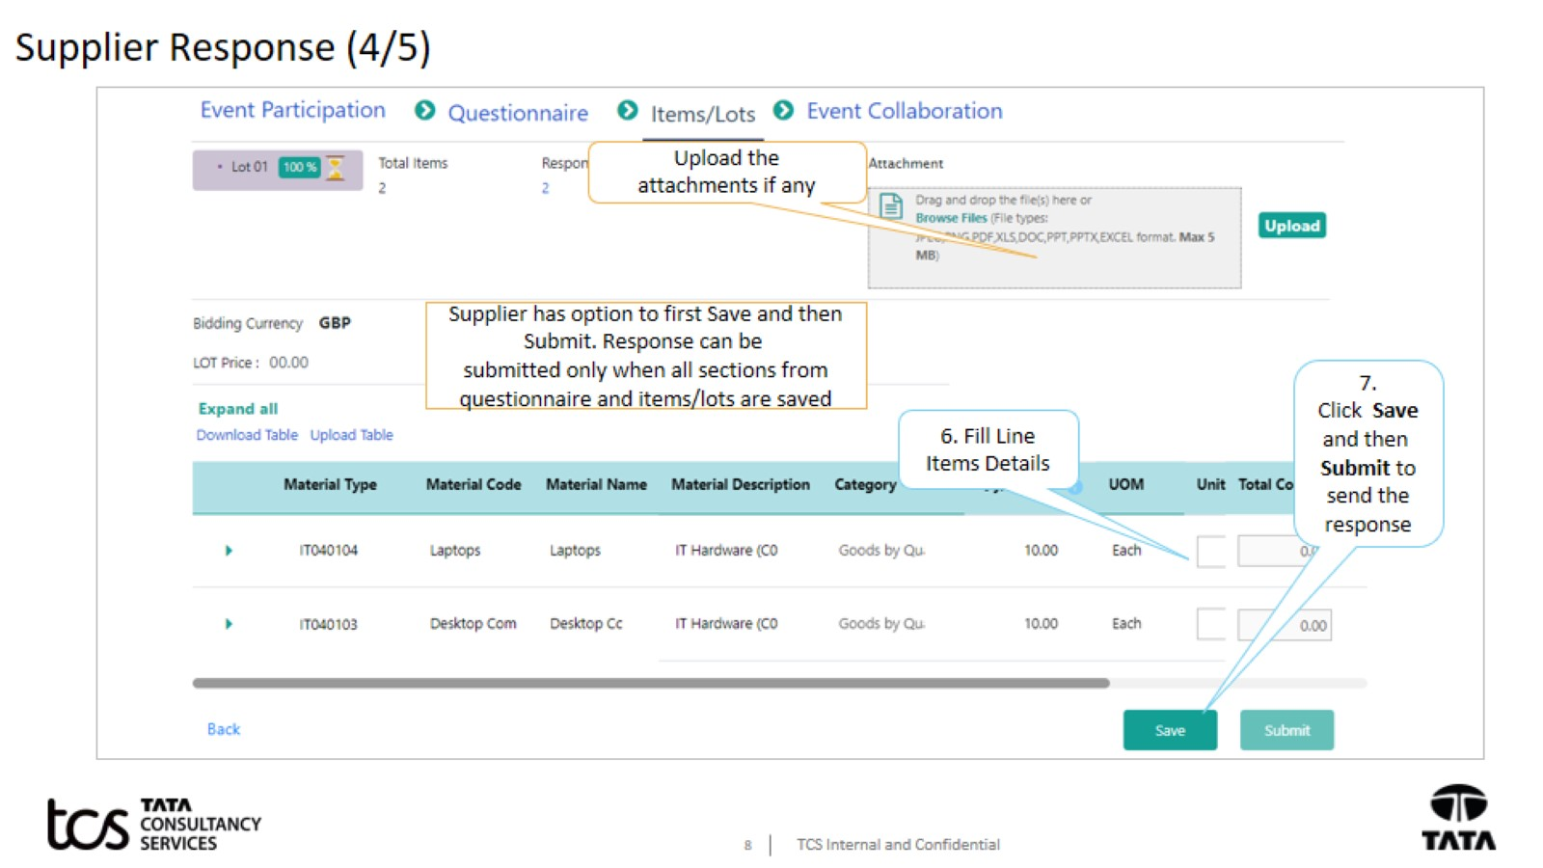
Supplier Response (4/5)

Slide 9
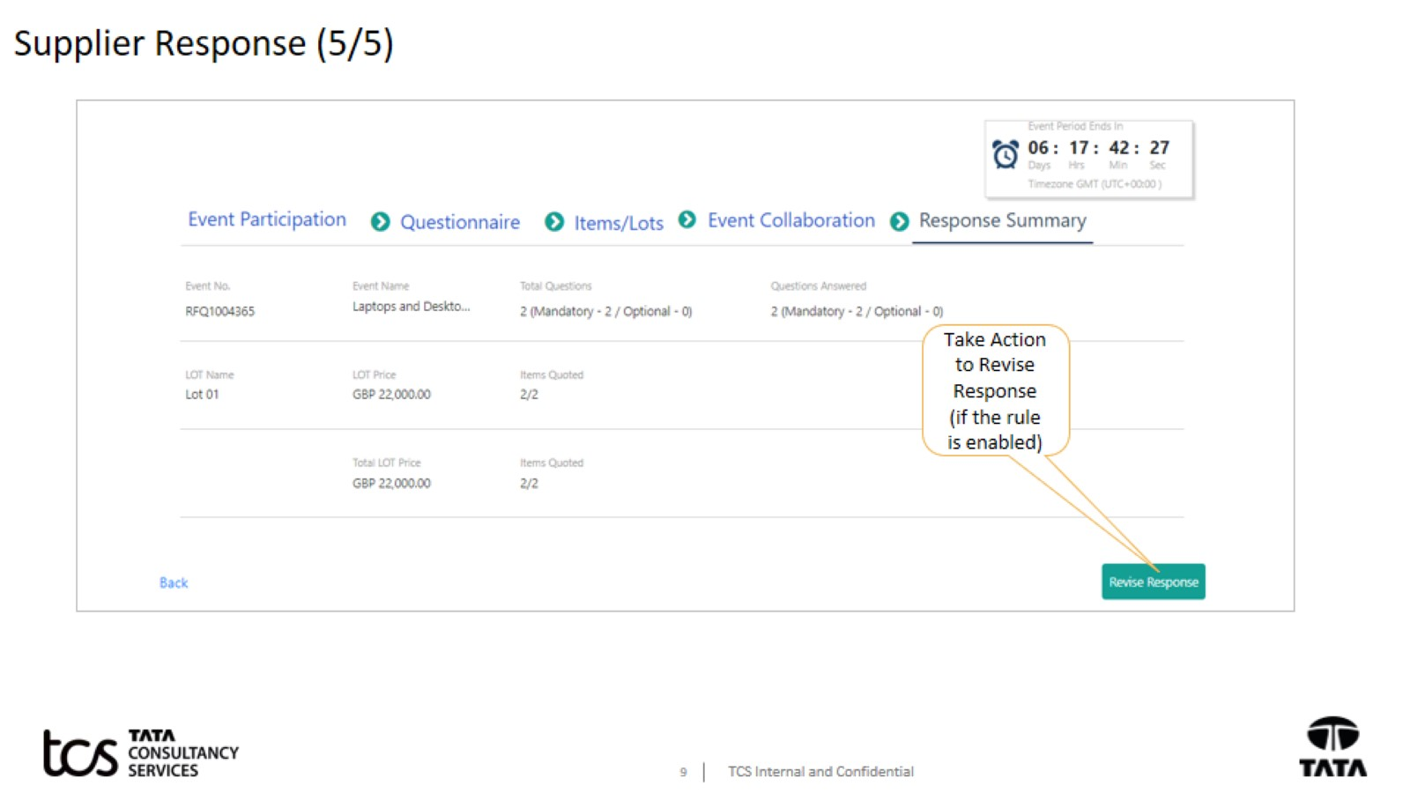
Supplier Response (5/5)

Slide 10
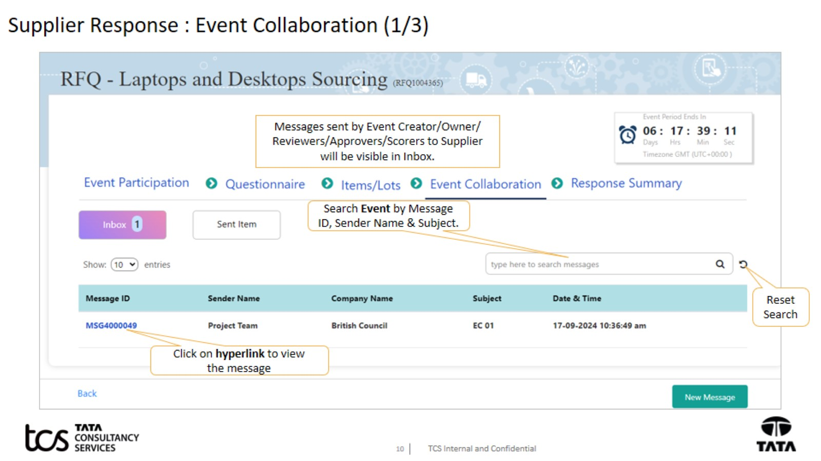
Supplier Response : Event Collaboration (1/3)

Slide 11
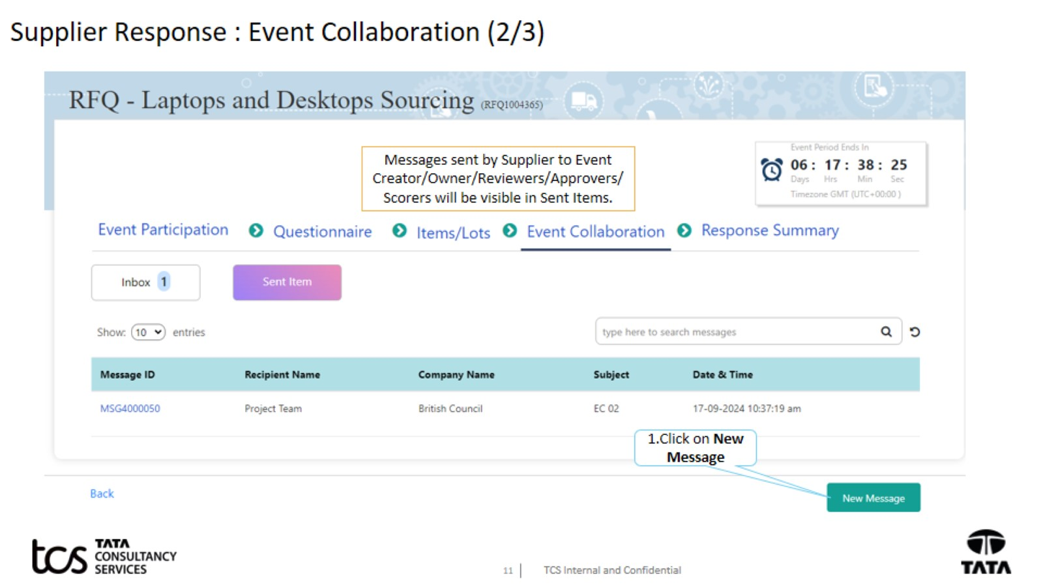
Supplier Response : Event Collaboration (2/3)

Slide 12
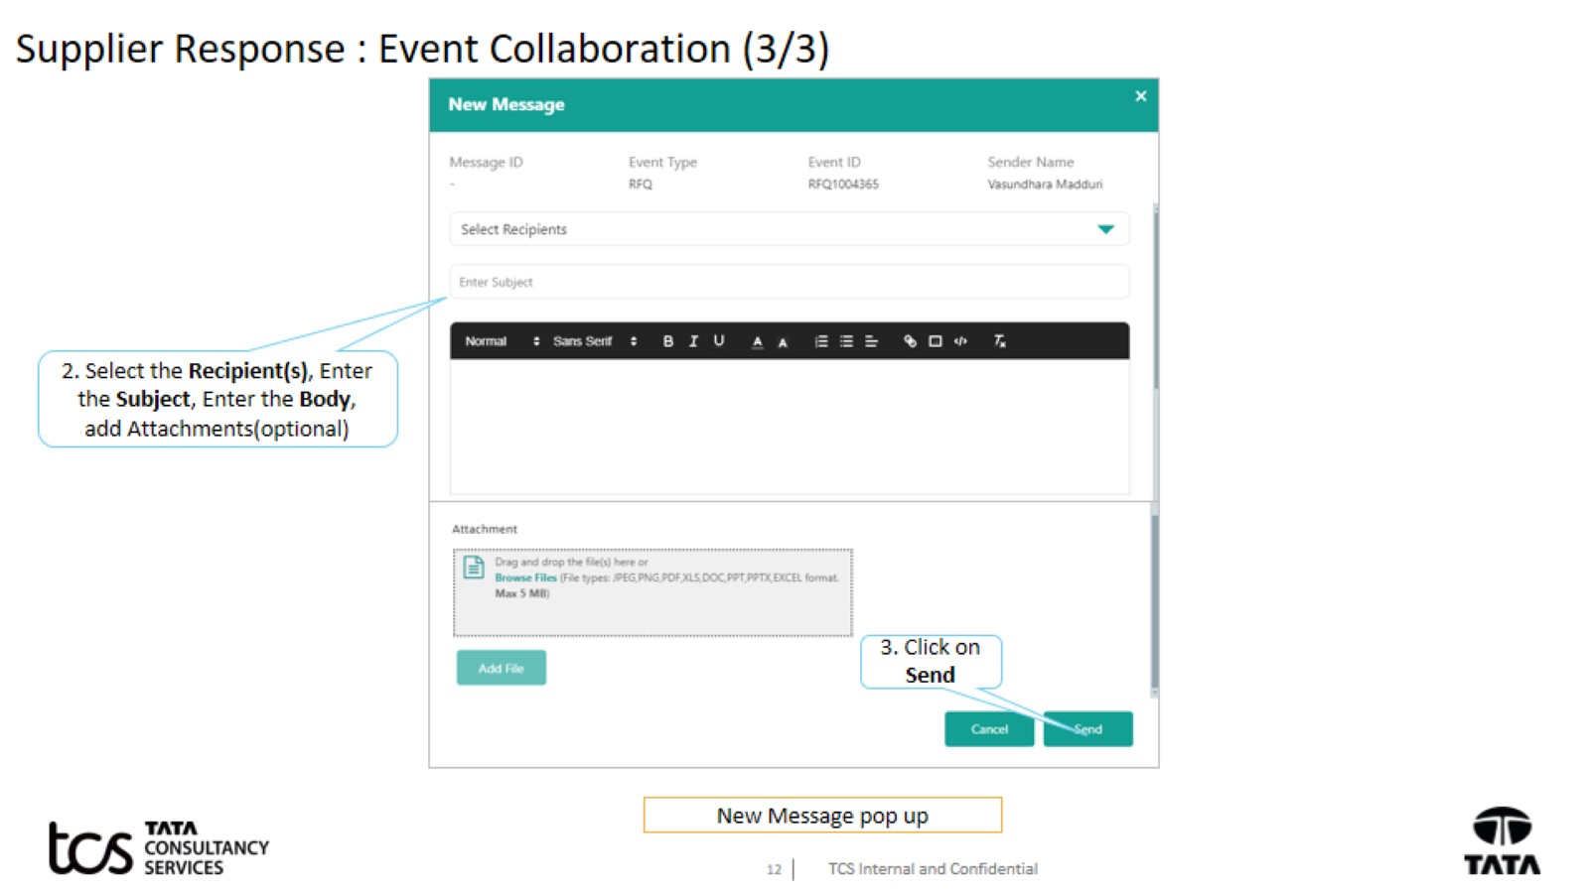
Supplier Response : Event Collaboration (3/3)

Slide 13


